Slide 1


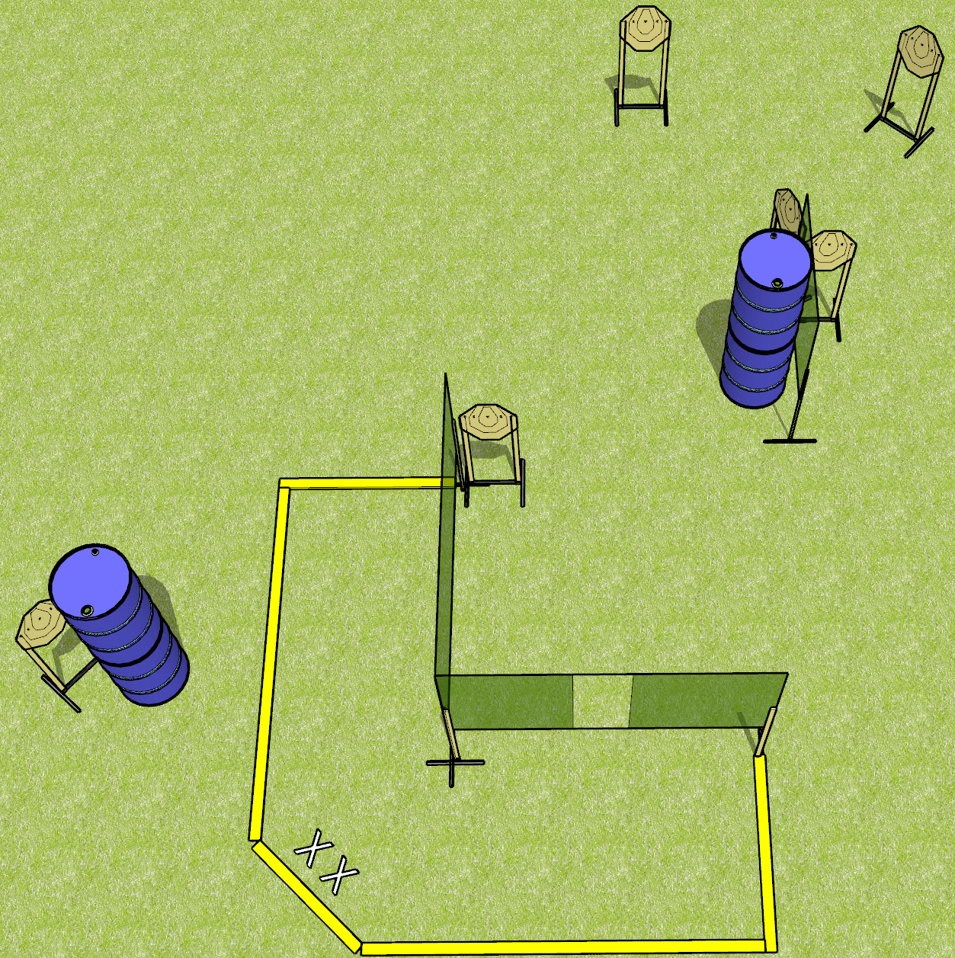
 | Dothan Gun Club – USPSA Match Strong and Weak Course Designer : Drew Coleman
Round Count 24 rounds 6 IPSC targets
Equipment List 5 wall feet 3 medium fault lines 6 targets

Slide 2
Strong and Weak
Written Stage Briefing
Strong and Weak is a 24 round, 120 point, Virginia Count standard exercise. There are 6 IPSC targets. The best 4 hits per target will score. The start signal is audible.
Handgun start position is heels on X’s, wrists below belt. Handgun is loaded and holstered.
PCC start position is heels on X’s, stock on belt. Loaded carbine is held with both hands, safety on.
String 1: on start signal, engage any 3 targets with 2 rounds each from within the shooting area. Perform a mandatory reload and engage the remaining 3 targets with 2 rounds each, strong hand only.
String 1: on start signal, engage any 3 targets with 2 rounds each from within the shooting area. Perform a mandatory reload and engage the remaining 3 targets with 2 rounds each, weak hand only.

